Slide 1
Colossians 1:9-14
(English Standard Version)

Slide 2
⁹ And so, from the day we heard, we have not ceased to pray for you, asking that you may be filled with the knowledge of his will in all spiritual wisdom and understanding, ¹⁰ so as to walk in a manner worthy of the Lord, fully pleasing to him: bearing fruit in every good work and increasing in the knowledge of God; ¹¹ being strengthened with all power, according to his glorious might, for all endurance and patience with joy; ¹² giving thanks to the Father, who has qualified you to share in the inheritance of the saints in light. ¹³ He has delivered us from the domain of darkness and transferred us to the kingdom of his beloved Son, ¹⁴ in whom we have redemption, the forgiveness of sins.

Slide 3
The Will of God –– Knowing it. Doing it.
The disconnect between the fleshly human question and the God’s Spiritual answer:
What’s God’s will (for my life’s program)? - desire for things to go well in life
God’s will, revealed and taught in His word: knowing God; making Godly decisions; living a holy life.
that you may be filled with the knowledge of his will in all spiritual wisdom and understanding
To love God with our minds (Not esoteric secret revelation)
Known and Taught Salvation will of God
v5 You have heard it (word of truth)
v6 You have heard it; understood it (grace of God in truth)
v7 You have learned it (the grace of God in truth)
Knowing the will of God helps us to live a Godly life.

Slide 4
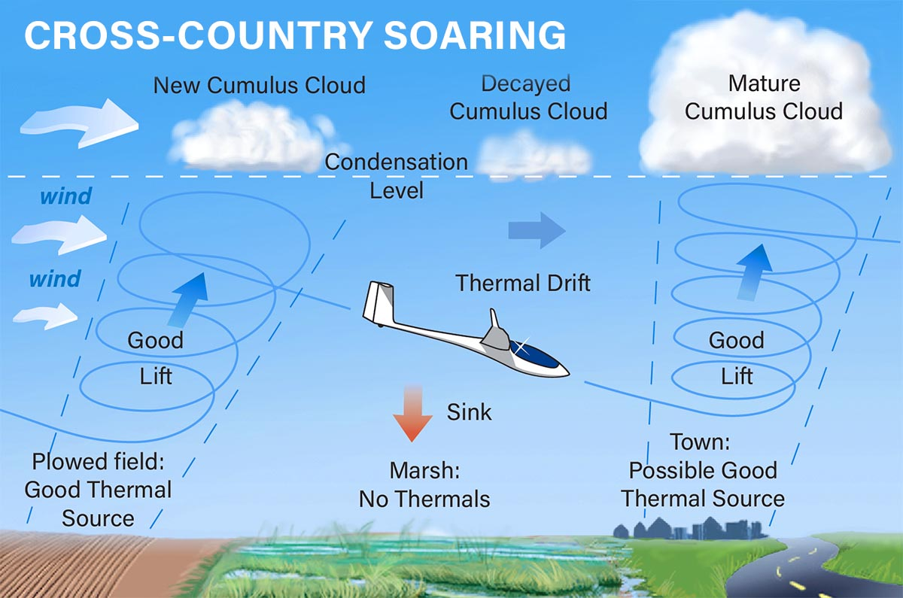

Slide 5
The Will of God –– Knowing it. Doing it.
The disconnect between the fleshly human question and the God’s Spiritual answer:
What’s God’s will (for my life’s program)? - desire for things to go well in life
God’s will, revealed and taught in His word: knowing God; making Godly decisions; living a holy life.
that you may be filled with the knowledge of his will in all spiritual wisdom and understanding
To love God with our minds (Not esoteric secret revelation)
Known and Taught Salvation will of God
v5 You have heard it (word of truth)
v6 You have heard it; understood it (grace of God in truth)
v7 You have learned it (the grace of God in truth)
Knowing the will of God helps us to live a Godly life.
Increases our knowledge of God’s will
Focus on God’s will He has already revealed.
As we bear Spiritual Fruit, He increases our knowledge of His will
¹¹ being strengthened with all power, according to his glorious might, for all endurance and patience with joy
long suffering
Walk in a manner
worthy of God
The power of God to be an overcomer (to be a faithful witness for Christ through trouble and tribulation)
Knowing God’s will

Slide 6
The Will of God –– Knowing it. Doing it.
The disconnect between the fleshly human question and the God’s Spiritual answer:
What’s God’s will (for my life’s program)? - desire for things to go well in life
God’s will, revealed and taught in His word: knowing God; making Godly decisions; living a holy life.
To love God with our minds (Not esoteric secret revelation)
Known and Taught Salvation will of God
v5 You have heard it (word of truth)
v6 You have heard it; understood it (grace of God in truth)
v7 You have learned it (the grace of God in truth)
Knowing the will of God helps us to live a Godly life.
Increases our knowledge of God’s will
Focus on God’s will He has already revealed.
As we bear Spiritual Fruit, He increases our knowledge of His will
The power of God to be an overcomer (to be a faithful witness for Christ through trouble and tribulation)
Walk in a manner
worthy of God
Christ died to redeem us from our sins
Qualified (through Christ) to Kingdom of Light
Knowing God’s will
¹² giving thanks to the Father, who has qualified you to share in the inheritance of the saints in light. ¹³ He has delivered us from the domain of darkness and transferred us to the kingdom of his beloved Son, ¹⁴ in whom we have redemption, the forgiveness of sins.

